Slide 1
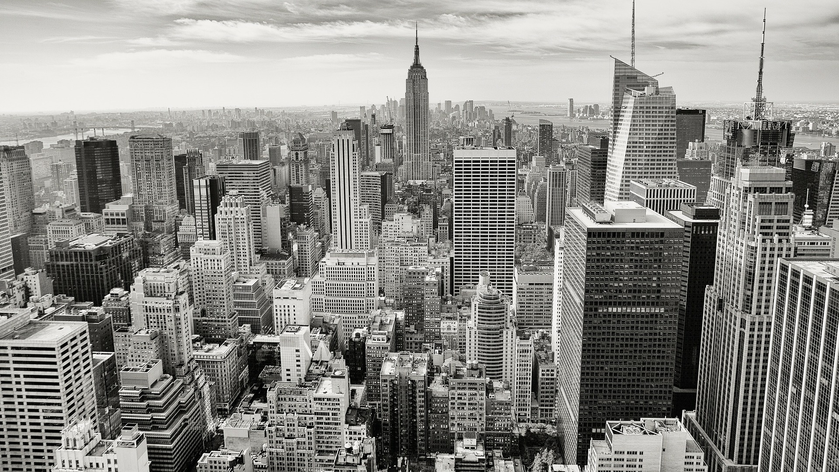

energAIze
12.07.2018

Slide 2







PROBLEM: DEMYSTIFYING THE ENERGY USAGE
2
and on a larger scale…
HAVE YOU EVERY WONDERED WHAT GOES INTO YOUR ELECTRICITY BILLS?
Energy usage per person around the world has been on the rise
1
2
Buildings contribute over 30% to 70% of total energy use
Electricity bills often leave many people perplexed
No easy way to manage electricity consumption & save cost
Buildings are a key contributor to greenhouse gas emissions
appliances
?
lights
Occupancy behaviour one of the most difficult parameters to predict & manage
heating/cooling
others

Slide 3
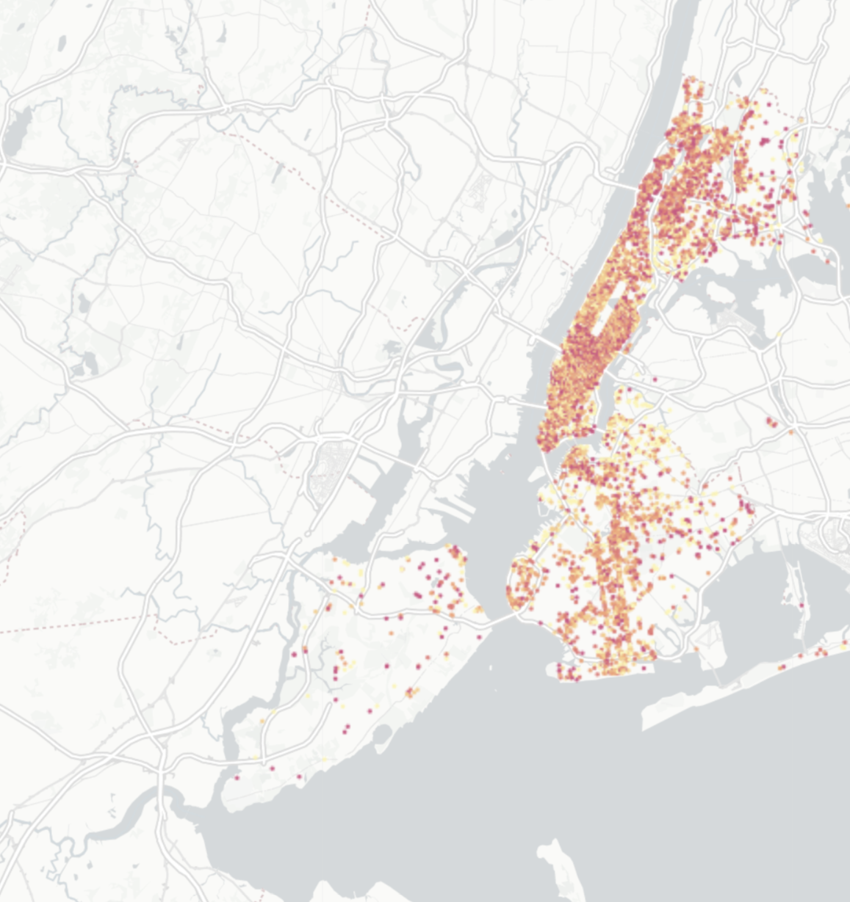
3
INVESTIGATING THE PROBLEM

Slide 4
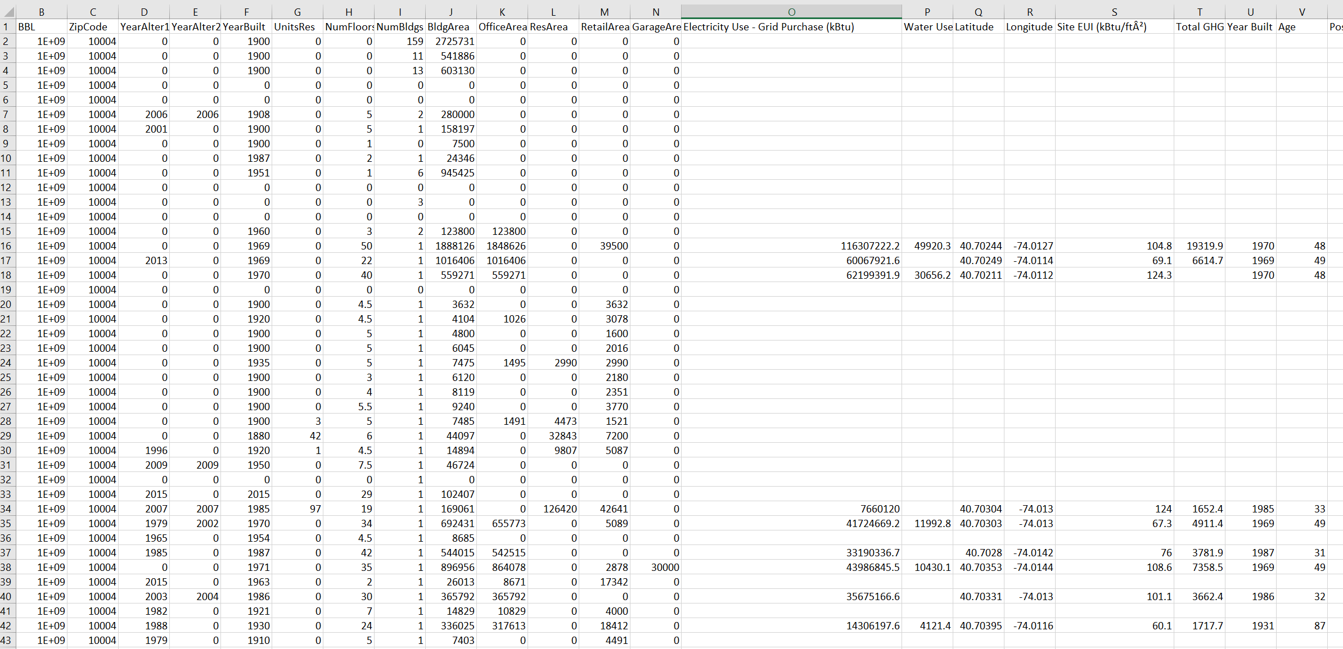
DATA WRANGLING AND CLEANING
2
Data Sources
Energy and Water Data Disclosure for Local Law 84 2017 (Data for Calendar Year 2016)
NYC PLUTO
Housing New York Units by Building
Couldn’t get granular data
Worked at BBL level

Slide 5
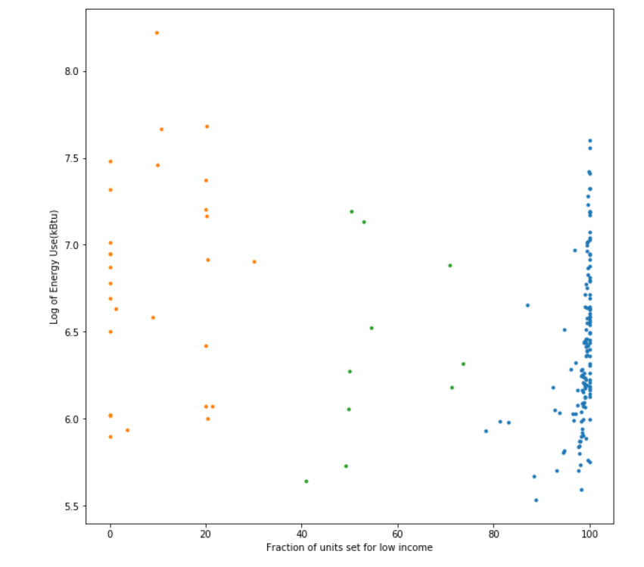
ANALYSIS
2
Random forest score
0.050847457627118647
Input features Age, BBL and fraction group

Slide 6
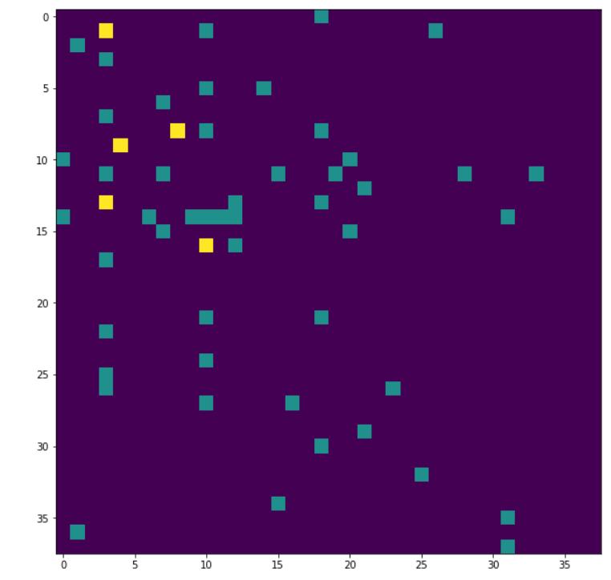
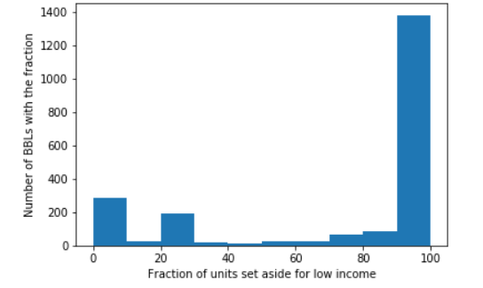
ANALYSIS
2
Confusion Matrix

Slide 7
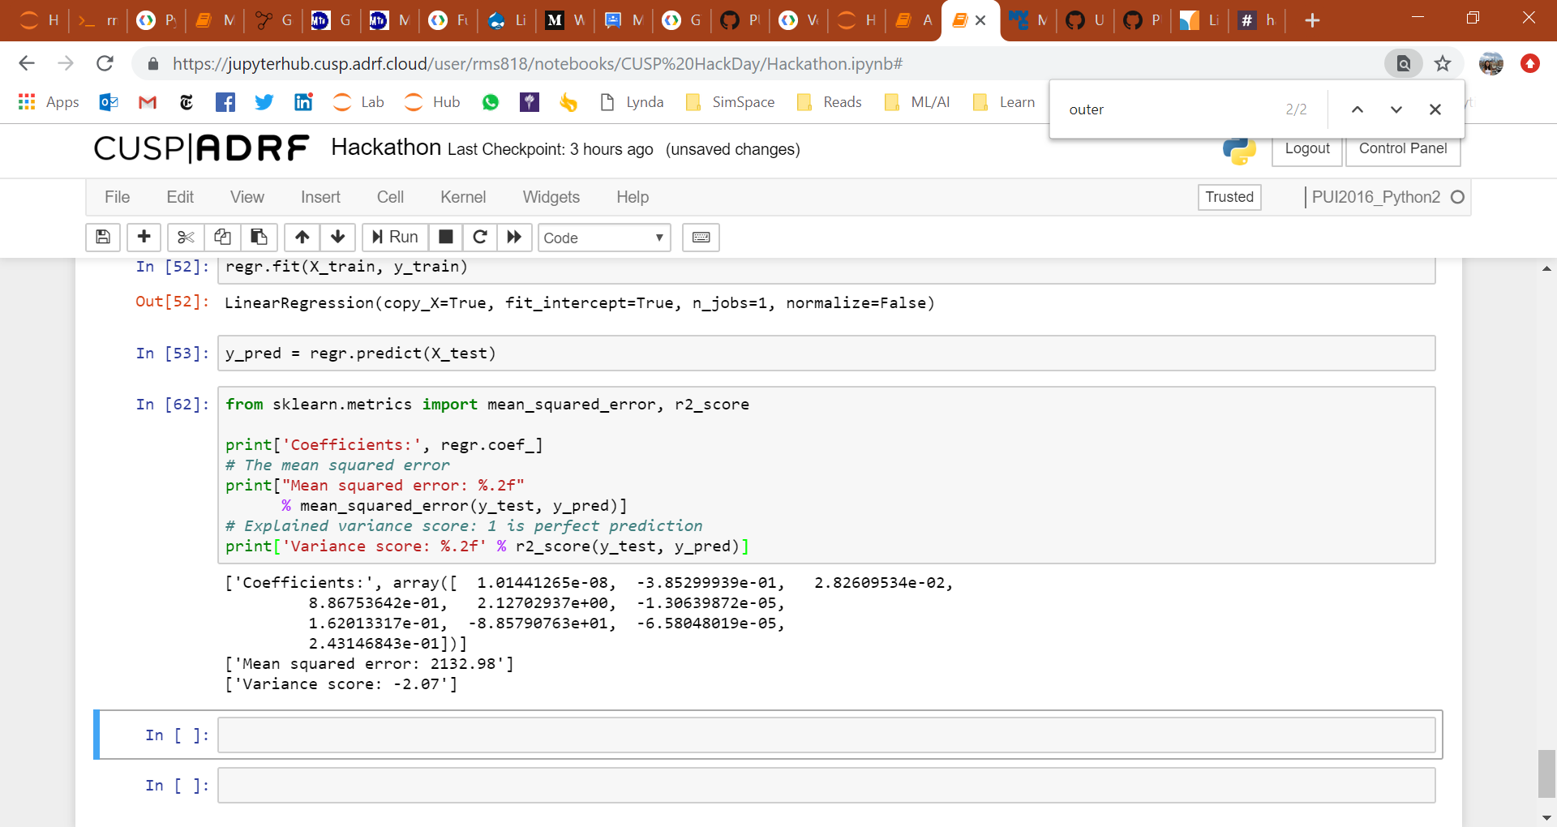
ANALYSIS
2

Slide 8



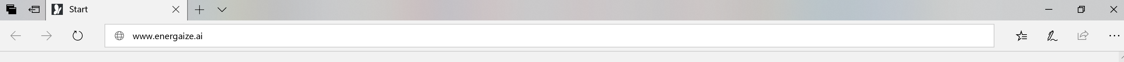
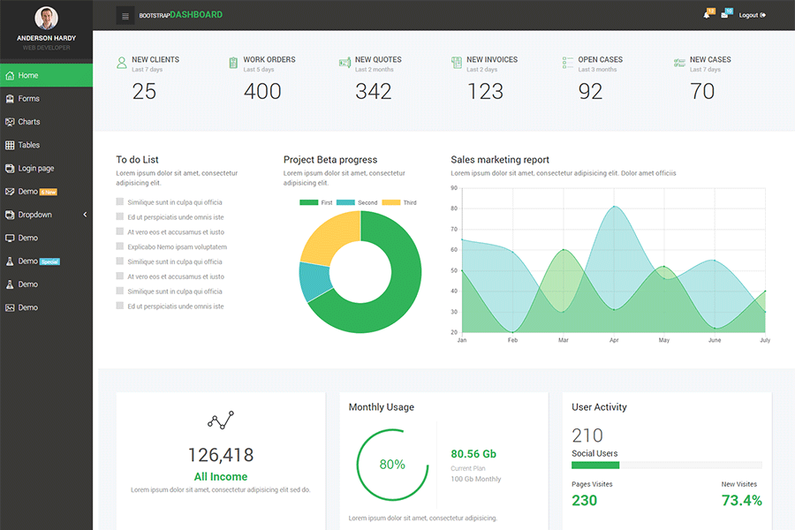
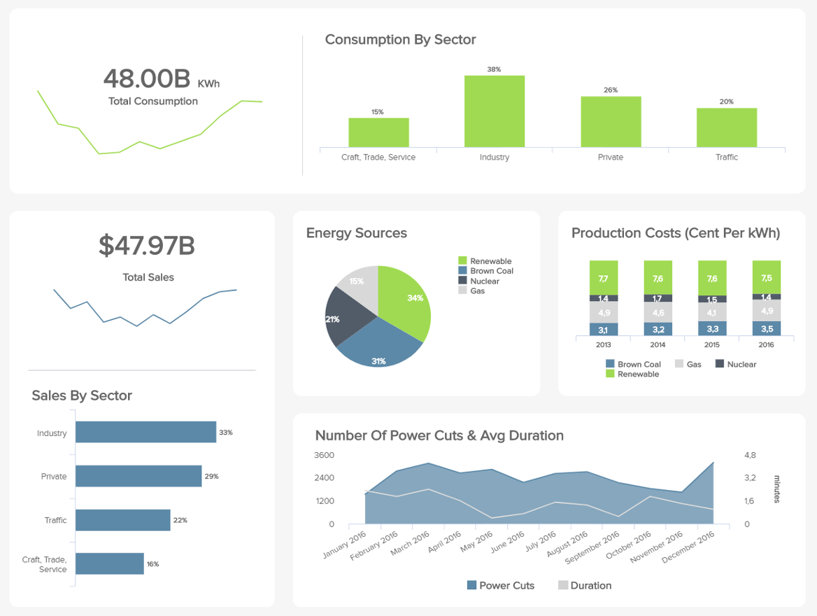

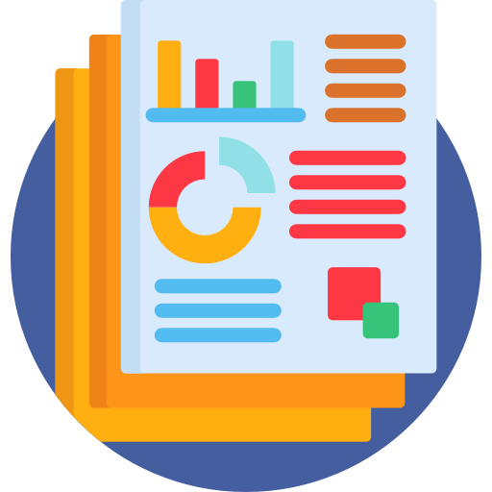


USE CASE I : POTENTIAL CONSULTANCY BUSINESS
4
User friendly, suitable for individual household or business users
energAIze
Analyse options for savings
450 kwH
Consumption
Consumption by Type
Understand energy usage
15% Reduction
Appliances
Energy Cost ($ per kWh)
Monthly Savings
Conduct predictive analysis
Historical Data
Compare against benchmarks
Designed to be compatible with existing appliances
Free webapp as “starter” – users can opt for personalised consultation after that. Individual data is then aggregated for future models.

Slide 9
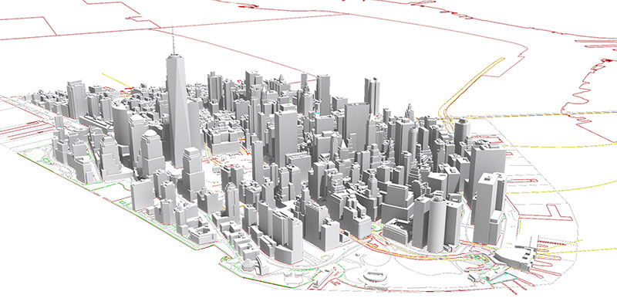
USE CASE 2 : SIMULATING FUTURE ENERGY CONSUMPTIONS
4
Source: https://www1.nyc.gov/site/planning/data-maps/open-data/dwn-nyc-3d-model-download.page

Slide 10
energAIze
THANK YOU

